Slide 1

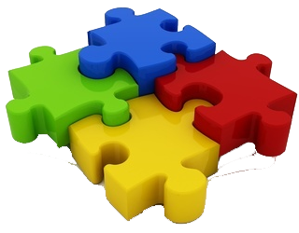

Slide 2
About today…
Redux
Actions
Reducers
Store

Slide 3

Redux
Actions, Reducers, Store

Slide 4
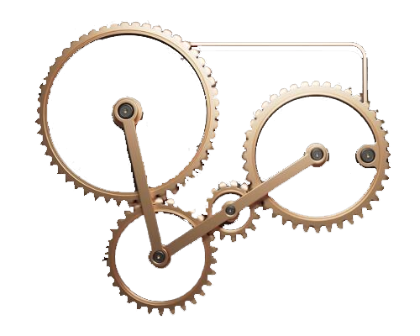
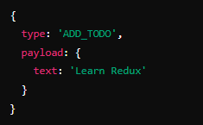
Introduction to Redux Actions
What is an Action?
An action is a plain JavaScript object that describes an event or change in the state of your application
Actions are the only way to send data to the Redux store
Structure
Key Points
Every action must have a type property, a string that indicates the type of action being performed
Actions can also contain a payload, which holds the data needed to update the state

Slide 5

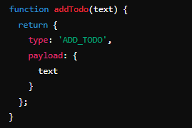
Creating Actions
Action Creators
Functions that create and return an action object
Help maintain consistency and readability in your code
Action Creator - Example
Benefits
Reusable and testable functions
Ensures actions are created consistently

Slide 6
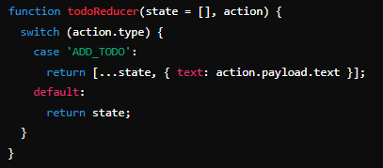
Understanding Reducers
What is a Reducer?
A function that takes the current state and an action as arguments and returns a new state
Must be a pure function, meaning it returns the same output given the same input and does not produce side effects
Action Creator - Example
Benefits
Uses a switch statement to handle different action types
Returns a new state object without mutating the original state

Slide 7
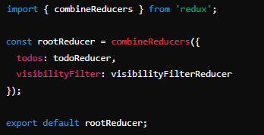
Combining Reducers
A helper function from Redux that combines multiple reducers into a single reducing function
Example
Benefits
Organizes state management by domain
Makes the codebase easier to manage and extend

Slide 8

The Redux Store
What is the Store?
A single object that holds the entire state of your application
Created using the createStore function from Redux
Creating a Store
Key Points
The store has methods like getState(), dispatch(action), and subscribe(listener) to interact with the state

Slide 9

Dispatching Actions
dispatch(action)
The primary method for updating the state in Redux
Sends an action to the Redux store, which then calls the appropriate reducer
Example
Key Points
Triggers a state change
Should be the only way to update the state

Slide 10

What is an action in Redux?
An action is a plain JavaScript object that describes an event or change in the state of the application
What must every action in Redux have?
Every action must have a type property
What is the role of a reducer in Redux?
A reducer is a function that takes the current state and an action as arguments and returns a new state
What does the combineReducers function do?
It combines multiple reducers into a single reducing function
How do you update the state in Redux?
By dispatching an action using the dispatch method of the store

Slide 11


Slide 12

Task
Create a simple to-do application using Redux

